Slide 1


Airbnb Case Study
PPT-II
By:
Kunal Sadana

Slide 2

Agenda
Objective
Background
Key Insights
Recommendations
Appendix
Solution
A web platform where users can rent out their space to host travelers to:

Slide 3

Background
Objective
Analyse the dataset consisting of various Airbnb listings in New York.
Understand some important insights based on various attributes in the dataset so as to increase the revenue.
For the past few months, Airbnb has seen a major decline in revenue.
Now that the restrictions have started lifting and people have started to travel more, Airbnb wants to make sure that it is fully prepared for this change.

Slide 4
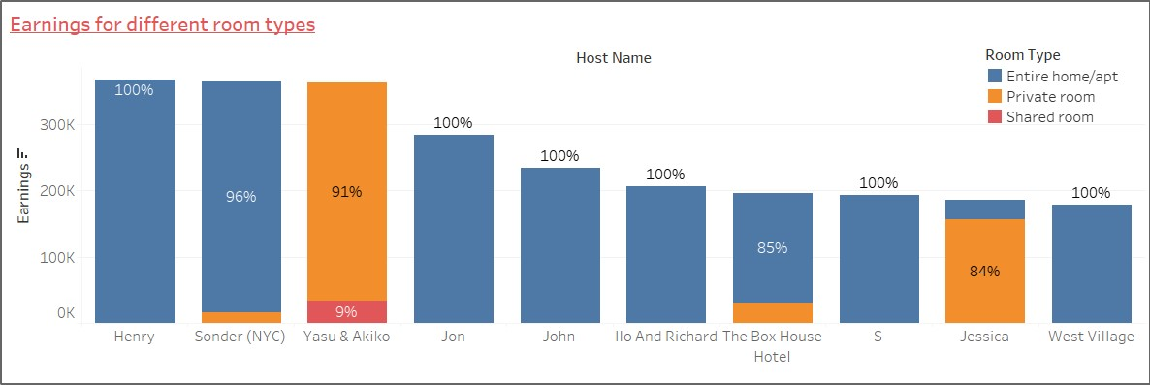
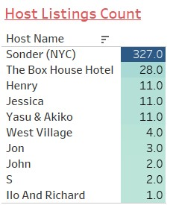
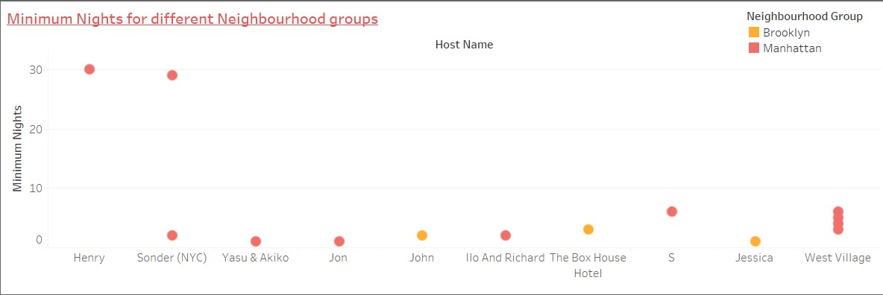
Top Hosts
Top 10 hosts by earnings.
Most of them have Entire Home/apartment as room type.
All have listings in Manhattan and Brooklyn area.

Slide 5
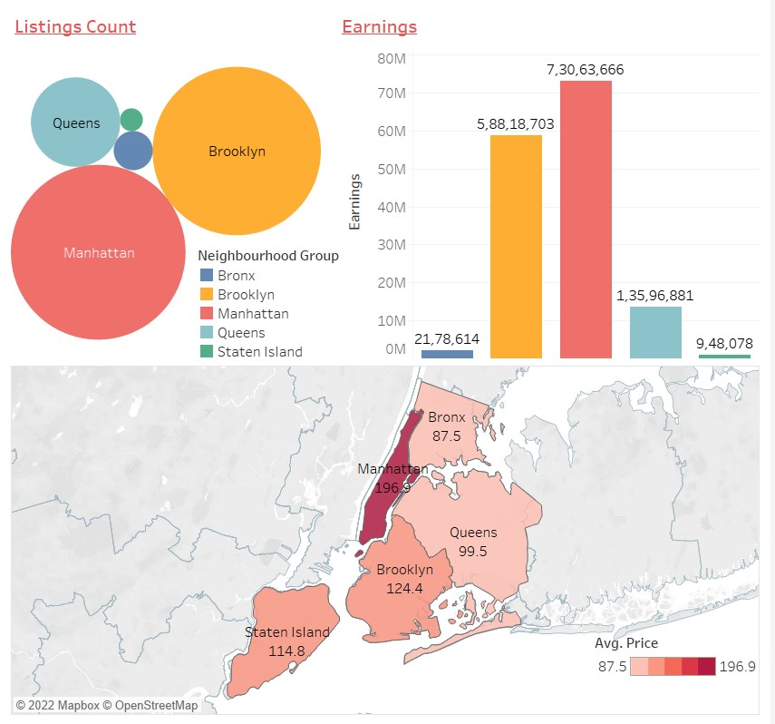
Neighbourhood Groups
The top New York City boroughs are Manhattan, Brooklyn, and Queens in this order.
Manhattan has the most volume, highest Average Price and is the most popular destination for Airbnb.
As one of the quietest boroughs, Staten Island is ideal for a peaceful stay from the hustle and bustle of the city and can be promoted more.

Slide 6
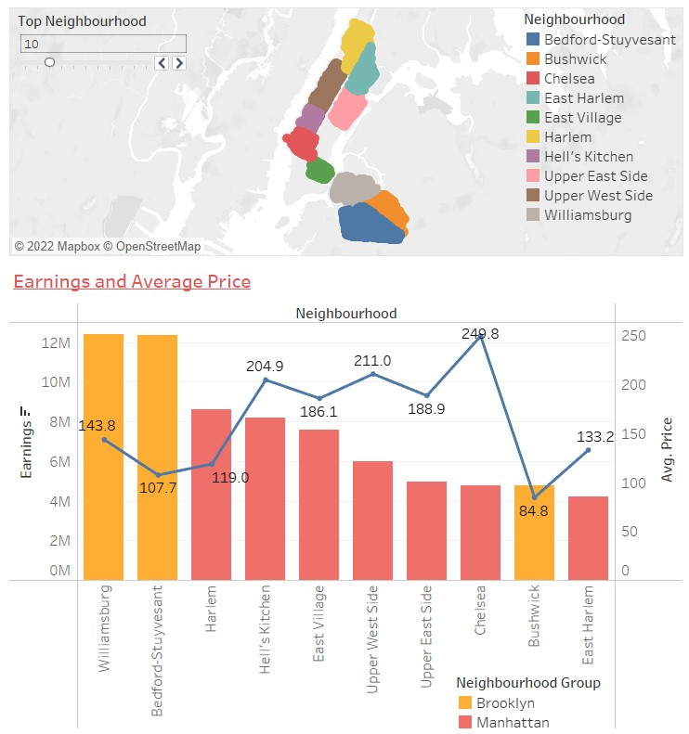
Top Neighbourhoods
Top 10 Neighbourhoods by earnings.
Most of them lie in Manhattan followed by Brooklyn.
Bushwik, Bedford-Stuyvesant and Harlem offer lowest Pricing.
Proximity to city attractions, the subway, and hip places are all factors that contribute to making these neighborhood famous and ideal for more investment.

Slide 7
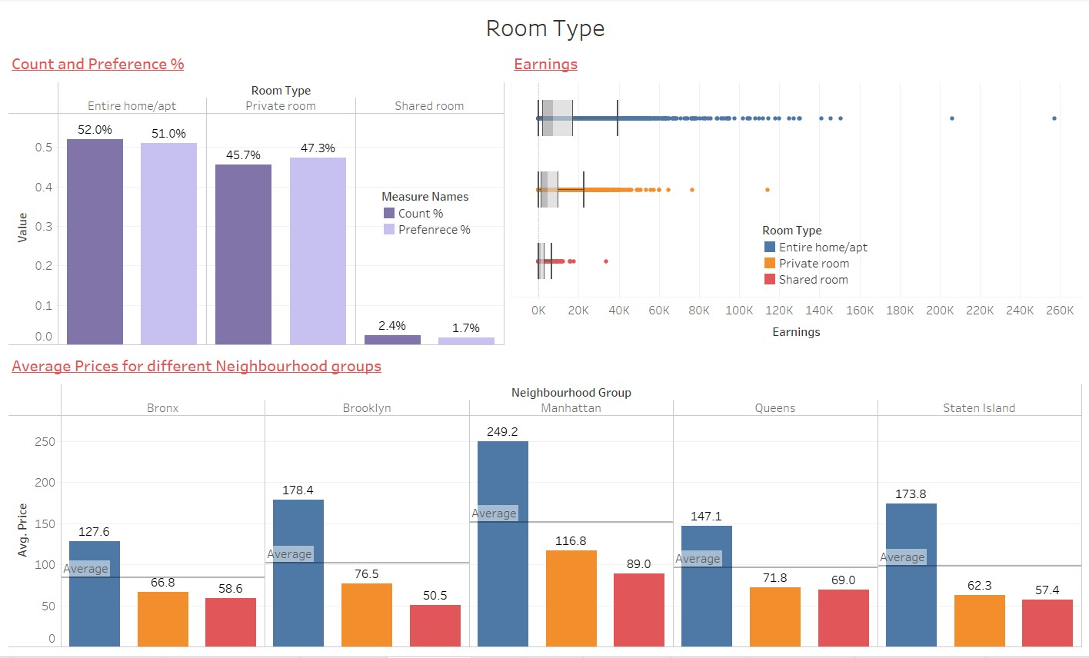
Property Types
Entire home/apartments have highest share of listing counts followed closely by Private rooms.
Most of the customers prefer Entire home/apartments and Private rooms with very few preferring Shared rooms.
Earnings via Entire home/apt is quite high making them ideal for more investments.

Slide 8
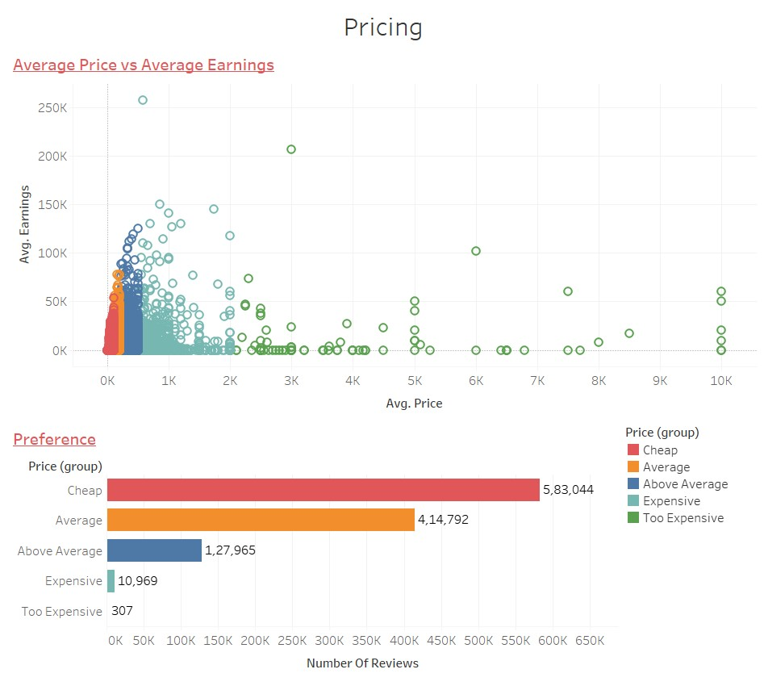
Pricing Ranges
Customers prefer properties having cheaper rates and very few have booked properties which are Expensive and too Expensive.
Average and Above Average Pricing categories result in most Earnings.

Slide 9
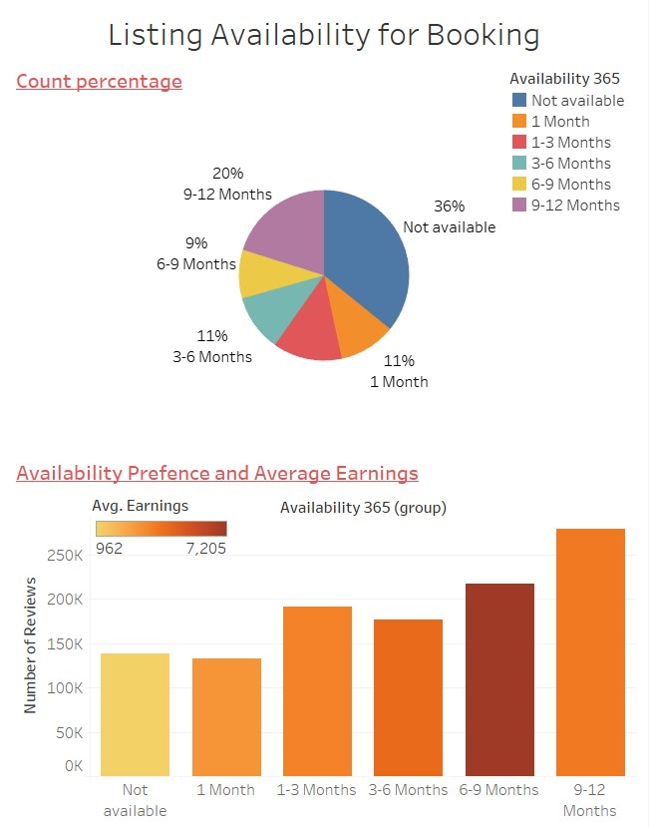
Availability for Booking
A lot of properties have been listed as “Not Available”. Low Earning being one of the reason.
People have preferred properties which are available for booking for more days in an year.
Properties available for 6-9 months top in Average Earnings.

Slide 10




Recommendations
Following insights should be focused on for further development or investment:
Hosts who have less number of properties listed and have Entire home/apartments as property type.
Manhattan and Brooklyn are the top New York city boroughs.
Harlem in Manhattan and Bedford-Stuyvesant in Brooklyn offer unique investment opportunity with less Average Price and high Earnings.
Listings having Average or Above Average Price range.
Listings available for booking for 6-9 months.

Slide 11

Appendix
A thorough analysis of the given dataset was conducted.
Data Methodology document has been attached with the file.

Slide 12
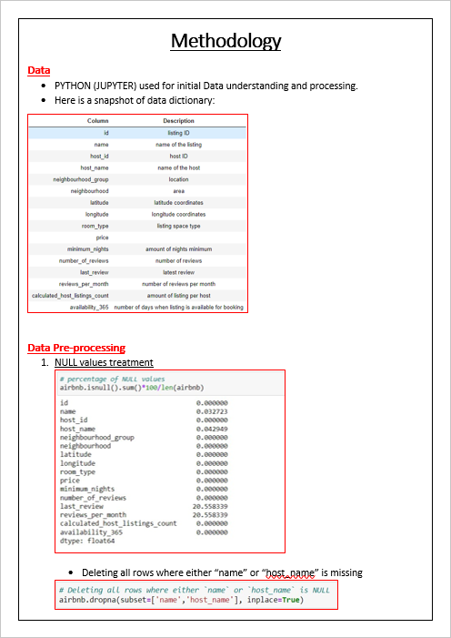
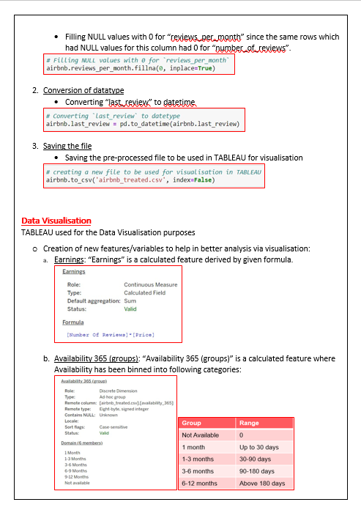
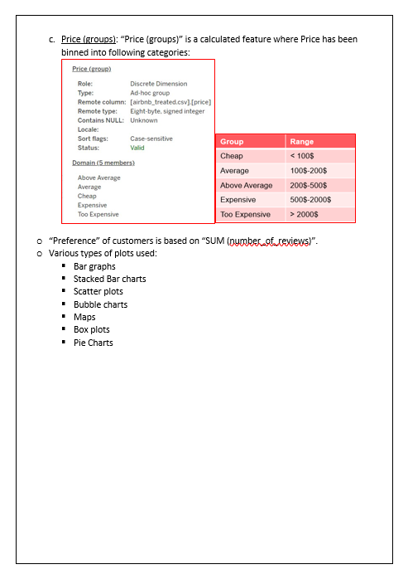
Appendix

